Slide 1

BOOLERS ANNUAL
CLIENT CONFERENCE
2026 – Planning for the future

Slide 2

WELCOME
Today’s agenda
10:30 – 10:35 Housekeeping
10:35 – 11:45 Session 1: Budget Presentation and Q&A with our expert panel
11:45 – 12:15 Teas and coffees
12:15 – 13:00 Session 2: Market Outlook
13:00 – 14:00 Lunch & Networking
14:00 Event close

Slide 3

SESSION 1:
BUDGET AND Q&A

Slide 4

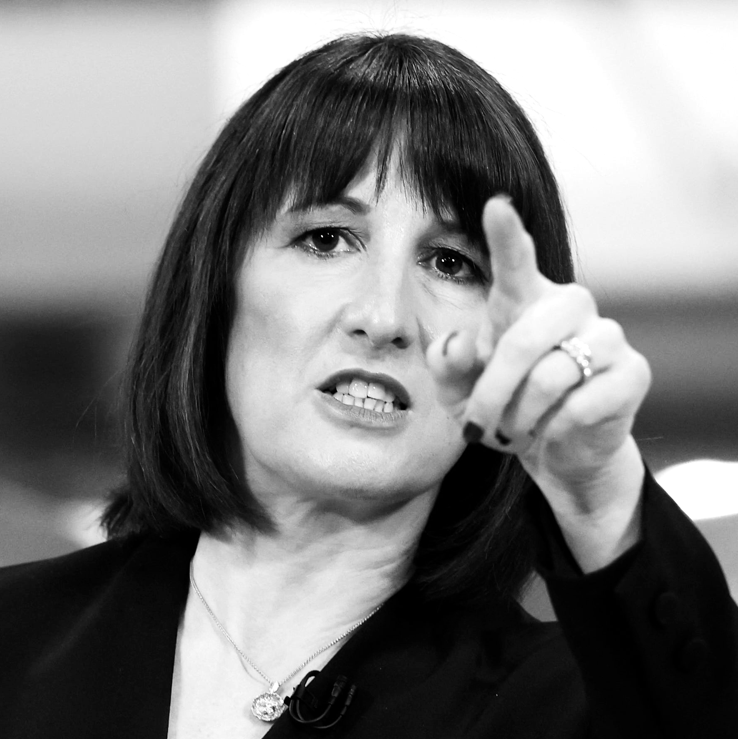
RACHEL REEVES BUDGET
FOR GROWTH
–THE SEQUEL
2024
“Labour inherited a £22 billion black hole”
Rachel Reeves – Chancellor of the Exchequer
2025
“Each of us must do our bit”
Rachel Reeves – Chancellor of the Exchequer

Slide 5

THE BUDGET HEADLINES
That matter to you
Dividend tax increased by 2% from April 2026
Savings and Property tax increased by 2%
from April 2027
‘Mansion Tax’ – High Value Council Tax
Surcharge April 2028
Electric and Hybrid Mileage Based charge
April 2028
Salary Sacrifice on Pensions April 2029
Employee Ownership Trust changes
APR and BPR limit increased to £2.5m per person instead of £1m

Slide 6

TAX RATE INCREASES
Tax Rates
Dividend, Savings and Property Income tax increased by 2% from April 2026
New rates;
FROM APRIL 2026 - Dividend Income 10.75%, 35.75% and 39.35%
FROM APRIL 2027 - Property Income 22%, 42% and 47%
FROM APRIL 2027 - Savings Income 22%, 42% and 47%
NOTE; the order of allowances and relief is changing from April 2027 with property, savings and dividend income only benefitting from reliefs and allowances after other income has ‘used them’…
Meaning the new higher rates apply more often.

Slide 7

SALARY EXCHANGE
Salary Exchange 2029
From 2029, salary exchange limited
to £2,000 on pensions
Huge implications for employers again
Estimated to raise £4.9bn p.a.
From 2029 onwards
Employer
Employee
Pension

Slide 8


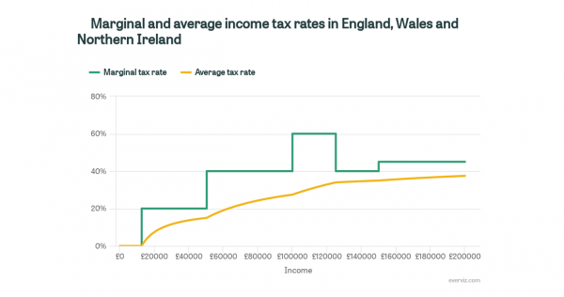
THE INCOME TAX TRAPS
Marginal and average income tax rates in England, Wales and Northern Ireland

Slide 9

EMPLOYEE OWNERSHIP TRUST
Still a solution?
Employee-Ownership Trust – Shareholders sell their shares into a trust which is held for the benefit of the employees. There is an exemption of CGT on shares sold to an Employee-Ownership Trust
Was 100% CGT relief, now 50% tax relief.

Slide 10

IHT ON PENSIONS
Current Level of Taxation on Pensions
Inheritance Tax (IHT) on Pensions;
Pensions do not form part of your Estate and pay 0% Inheritance Tax
Income Tax on Pensions;
PRE AGE 75 - your beneficiaries can access your pension free of Income Tax
POST AGE 75 - your beneficiaries pay income tax at their marginal rate of tax

Slide 11
IHT ON PENSIONS
October 2024 Budget announcement
Pensions will be brought into Inheritance Tax regime
from April 2027
Pension values will be added to estate values and Inheritance Tax calculated on the total
IHT liability split between estate and pension based on their proportion of total value
Spousal exemption remains

Slide 12
IHT ON PENSIONS
What we know
Draft Legislation issued July 2025
Shifted burden of reporting and paying IHT from Pension Scheme Administrators (SAs) to Personal Representatives (PRs) of estates
PRs responsible for collating values of pension assets and determining IHT liability for estate and pension beneficiaries
Joint and several liability for paying IHT between PRs and pension beneficiaries

Slide 13
IHT ON PENSIONS
What we know
Pension Scheme Administrators must
Provide pension valuation to PR within 4 weeks of
death notification
Discretionary schemes must confirm who the beneficiaries are and whether they are exempt or non‑exempt
4‑week deadline replaces current 2‑year allowance for complex valuations
Valuation issues with illiquid assets

Slide 14
IHT ON PENSIONS
What we know
Personal Representatives must
Obtain values of all estate and pension scheme assets
to determine if IHT is due
Submit combined IHT account to HMRC
Notify SAs and beneficiaries of any IHT due on
pension benefits
Where IHT is due, PRs and pension beneficiaries are jointly/ severally liable, but PRs can instruct SAs to pay IHT due to HMRC before paying any benefits
IHT due on pension (only) may be paid from estate or pension scheme

Slide 15
IHT ON PENSIONS
Consider
If illiquid assets in pension scheme paying IHT from estate
If death is post 75, paying IHT from pension will reduce amount of income tax paid by beneficiaries
Consolidating pension pots to simplify administration
Using surplus pension income for exempt gifting
Gifting and pension-funded life cover in trust

Slide 16

WHAT CAN WE DO ABOUT IT?
Use your allowances – ISA, Capital Gains Tax, Gifting Allowances
Consider making gifts
  Use your allowances
  Gifts out of surplus income
Consider Business Property Relief solutions
Contemplate insurance options
Spend your money better than the government will!

Slide 17

INHERITANCE TAX PLANNING OPTIONS
Asset Reduction
Asset Freezing
Asset Conversion
Gifting
Spending
Growth shares
Loan trusts
Interest free loans
AIM shares?
Business Property Relief solutions

Slide 18

ASSET REDUCTION STRATEGIES
Gifts out of surplus income
Gifting explicitly & spending!
Gifts
into trust
IHT 403 form
Some tax free income counts (ISAs)
Regularity is important
Discretionary or bare?
7 year clock?
Limited to £325k per person?
10 year periodic charges?
Gifting explicitly, easy
and ‘cheap’
Spending on anything other than assets
Do the pension changes invite more of an effort to consciously give assets away?

Slide 19

THE RESIDENCE NIL RATE BAND TRAP
Family 1
Family 2
Personal wealth £1.5m
Pension £500k
Estate £2m
Full allowances £1m
Personal wealth £2m
Pension £700k
Estate £2.7m
Allowances now max £650k
£1m @ 40% = £400k tax
£2.05m @ 40% = £820k tax

Slide 20
ASSET FREEZING
Loan to children to
buy assets
Loan to trust to
maintain control
Growth share
strategy

Slide 21

ASSET CONVERSION
Use the Business Property Relief allowance that you have available.
£2.5m Per Person

Slide 22
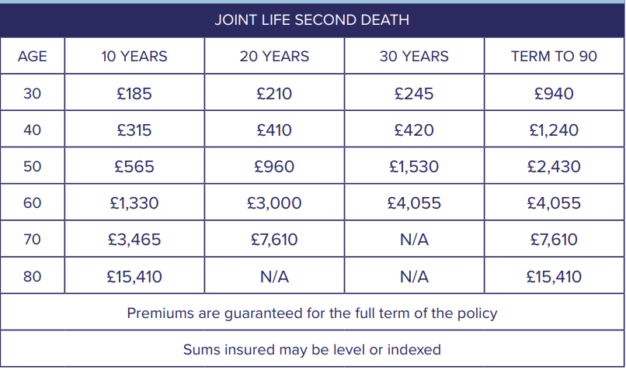
INSURANCE AS AN OPTION?

Slide 23

SUMMARY
Another aggressive budget
Pension and personal estate planning must be considered together
Consider the potential for insurance to help with liquidity
Challenge whether IHT strategies can be pursued more than before
Make your tax choices consciously and deliberately
Watch for the tax traps!
We are here to help

Slide 24

Q&A
Carole Waghorne
Boolers
Craig Simpson
Simon Watts
Boolers
Gavin O’Neill
Boolers
Chris Ball
Boolers

Slide 25
SESSION 2
MARKET OUTLOOK

Slide 26

THE SECOND HALF
10:30 – 10:35 Housekeeping
10:35 – 11:45 Session 1: Budget Presentation and Q&A with our expert panel
11:45 – 12:15 Teas and coffees
12:15 – 13:00 Session 2: Market Outlook
13:00 – 14:00 Lunch & Networking
14:00 Event close

Slide 27

KEY INVESTMENT THEMES
Presented by Simon Watts, Chartered FCSI, FPFS

Slide 28

Notes:
How AI visualized investment markets in 2025

Slide 29
AGENDA
A Review of our 2025 Outlook
What Actually Happened in 2025
The Art of the Tariff
Calmer Markets, Louder Politics
Make Volatility Great Again
De-Dollarisation: The Dollar’s Midlife Crisis
2026: Heads or Tails?
Our Current Positioning
Notes:
I’ll firstly look back at what we told you we thought could happen last year, then review what actually did occur.
Then I’ll touch on 4 themes:
Tariffs
Why markets are low volatility when there is so much uncertainty in the world
If that lack of volatility means investors have become complacent, and
Consider the impact of several nations shunning the Dollar,
Before taking a look forward to the coming year and outlining our current positioning

Slide 30
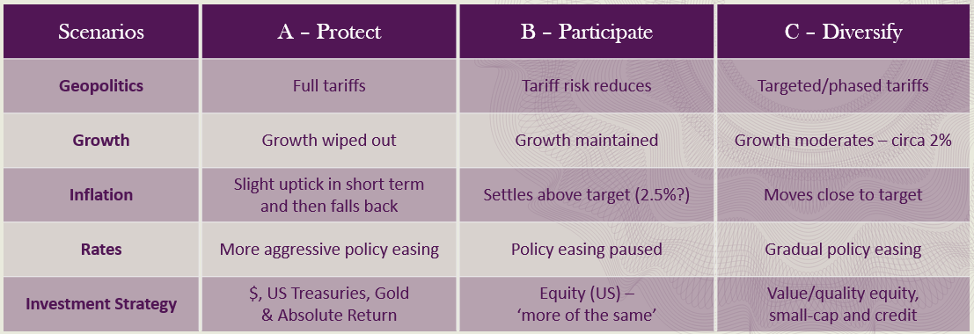
A REVIEW OF OUR 2025 OUTLOOK
Notes:
Last year we outlined three market scenarios tied to Trump’s proposed tariffs.
In the end, all three played out — Scenario A in April, Scenario C in May, and Scenario B through the rest of the year.

Slide 31


TRUMP’S IMPACT
Highly Active
Global Disruptor:
  Politics
  Economics
  Trade
  Markets
TACO?
Notes:
Highly Active – he’s everywhere – half the stories on Bloomberg TV
Global Disruptor:
Politics - think 8 wars plus Russia/Ukraine, Venezuela, Iran, Greenland, NATO, UN, Immigration
Economies – Fed interference over interest rates (monetary) & his "One Big Beautiful Bill“ (fiscal)
Trade – Tariffs & Sanctions, rare earth mineral deals, oil
Markets – natural consequence of disrupting the above 3
TACO? – A necessary safety valve for markets & economic growth which are essential for his success

Slide 32

WHAT ACTUALLY HAPPENED IN 2025
Key Global Economic Data
Global Real GDP growth of around 1.8%
Notes:
Real GDP Growth = above inflation, nominal = before inflation, e.g. UK nominal GDP growth for year to end of Q3 2025 = 4.8%, but only 1.3% real GDP as inflation was 3.5%.
Inflation moderating – not out of the woods yet, but the clearing is in sight.
Unemployment – slightly higher but generally holding up.

Slide 33
Economy | Nominal GDP YoY (estimated) | GDP implied deflator YoY | Real GDP YoY
United Kingdom | 4.80% | 3.50% | 1.30%
United States | 8.24% | 3.84% | 4.40%
Eurozone | 3.80% | 2.40% | 1.40%
Japan | 4.10% | 3.00% | 1.10%
China | 4.80% | 0.00% | 4.80%
Notes:
Real GDP Growth = above inflation, nominal = before inflation, e.g. UK nominal GDP growth for year to end of Q3 2025 = 4.8%, but only 1.3% real GDP as inflation was 3.5%.
Inflation moderating – not out of the woods yet, but the clearing is in sight.
Unemployment – slightly higher but generally holding up.

Slide 34
WHAT ACTUALLY HAPPENED IN 2025
Key Global Economic Data
Global Real GDP growth of around 1.8%
Global Inflation around 4.2%
Notes:
Real GDP Growth = above inflation, nominal = before inflation, e.g. UK nominal GDP growth for year to end of Q3 2025 = 4.8%, but only 1.3% real GDP as inflation was 3.5%.
Inflation moderating – not out of the woods yet, but the clearing is in sight.
Unemployment – slightly higher but generally holding up.

Slide 35
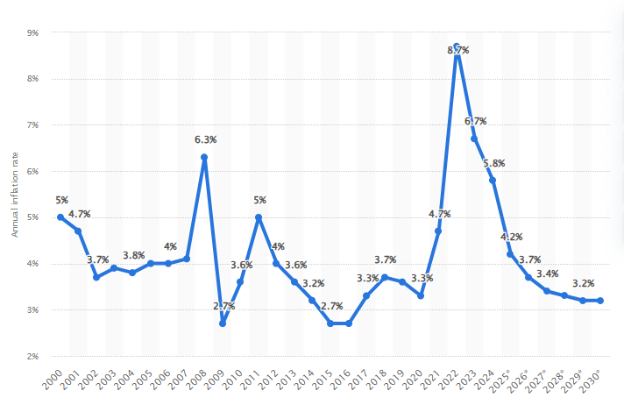
WHAT ACTUALLY HAPPENED IN 2025
Notes:
Real GDP Growth = above inflation, nominal = before inflation, e.g. UK nominal GDP growth for year to end of Q3 2025 = 4.8%, but only 1.3% real GDP as inflation was 3.5%.
Inflation moderating – not out of the woods yet, but the clearing is in sight.
Unemployment – slightly higher but generally holding up.

Slide 36
WHAT ACTUALLY HAPPENED IN 2025
Key Global Economic Data
Global Real GDP growth of around 1.8%
Global Inflation around 4.2%
Labour markets resilient but softening
Notes:
Real GDP Growth = above inflation, nominal = before inflation, e.g. UK nominal GDP growth for year to end of Q3 2025 = 4.8%, but only 1.3% real GDP as inflation was 3.5%.
Inflation moderating – not out of the woods yet, but the clearing is in sight.
Unemployment – slightly higher but generally holding up.

Slide 37
WHAT ACTUALLY HAPPENED IN 2025
Financial Markets
Global equity markets performed strongly, despite wobbles in February & April
Notes:
Good year across the board for equities, but the wobble was a short-lived bear market for some (correction >20% - S&P 500 in Sterling over 3 months)
UK did better, pipped by Europe; China was doing great but fizzled out towards the end.
Bonds (in blue) and alternatives (in green) provided a decent full year return of 7-8%; however, they provided excellent short-term support when equities tanked in April. If you were withdrawing money during these 3 months you would have been glad of them.
Gold & Silver became the new Bitcoin, whilst Bitcoin was all volatility & no return. We had been monitoring precious metals since before 2025 and jumped in during October just before things got really exciting with exposure via a Global Mining ETF.

Slide 38
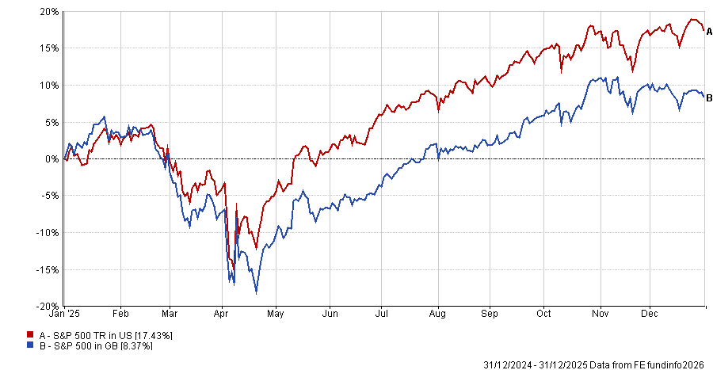
Notes:
Good year across the board for equities, but the wobble was a short-lived bear market for some (correction >20% - S&P 500 in Sterling over 3 months)
UK did better, pipped by Europe; China was doing great but fizzled out towards the end.
Bonds (in blue) and alternatives (in green) provided a decent full year return of 7-8%; however, they provided excellent short-term support when equities tanked in April. If you were withdrawing money during these 3 months you would have been glad of them.
Gold & Silver became the new Bitcoin, whilst Bitcoin was all volatility & no return. We had been monitoring precious metals since before 2025 and jumped in during October just before things got really exciting with exposure via a Global Mining ETF.

Slide 39
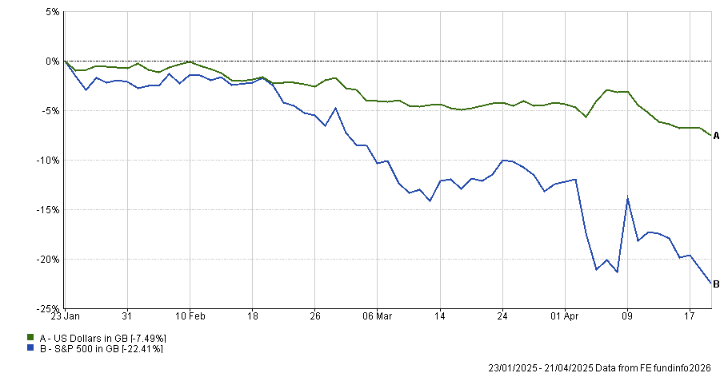
Notes:
Good year across the board for equities, but the wobble was a short-lived bear market for some (correction >20% - S&P 500 in Sterling over 3 months)
UK did better, pipped by Europe; China was doing great but fizzled out towards the end.
Bonds (in blue) and alternatives (in green) provided a decent full year return of 7-8%; however, they provided excellent short-term support when equities tanked in April. If you were withdrawing money during these 3 months you would have been glad of them.
Gold & Silver became the new Bitcoin, whilst Bitcoin was all volatility & no return. We had been monitoring precious metals since before 2025 and jumped in during October just before things got really exciting with exposure via a Global Mining ETF.

Slide 40
WHAT ACTUALLY HAPPENED IN 2025
Financial Markets
Global equity markets performed strongly, despite wobbles in February & April
UK equities were near the top of the pack, US equities underperformed
Notes:
Good year across the board for equities, but the wobble was a short-lived bear market for some (correction >20% - S&P 500 in Sterling over 3 months)
UK did better, pipped by Europe; China was doing great but fizzled out towards the end.
Bonds (in blue) and alternatives (in green) provided a decent full year return of 7-8%; however, they provided excellent short-term support when equities tanked in April. If you were withdrawing money during these 3 months you would have been glad of them.
Gold & Silver became the new Bitcoin, whilst Bitcoin was all volatility & no return. We had been monitoring precious metals since before 2025 and jumped in during October just before things got really exciting with exposure via a Global Mining ETF.

Slide 41
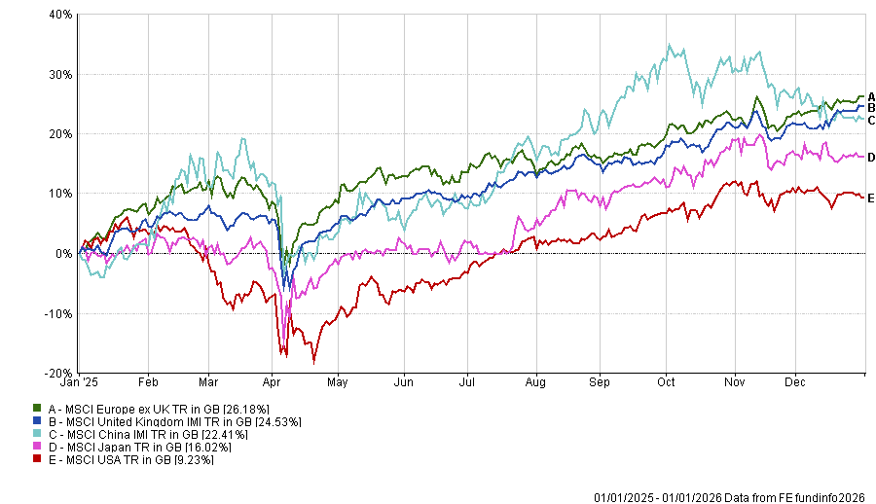
WHAT ACTUALLY HAPPENED IN 2025
Notes:
Good year across the board for equities, but the wobble was a short-lived bear market for some (correction >20% - S&P 500 in Sterling over 3 months)
UK did better, pipped by Europe; China was doing great but fizzled out towards the end.
Bonds (in blue) and alternatives (in green) provided a decent full year return of 7-8%; however, they provided excellent short-term support when equities tanked in April. If you were withdrawing money during these 3 months you would have been glad of them.
Gold & Silver became the new Bitcoin, whilst Bitcoin was all volatility & no return. We had been monitoring precious metals since before 2025 and jumped in during October just before things got really exciting with exposure via a Global Mining ETF.

Slide 42
WHAT ACTUALLY HAPPENED IN 2025
Financial Markets
Global equity markets performed strongly, despite wobbles in February & April
UK equities were near the top of the pack, US equities underperformed
Bond markets and alternative investments provided support during equity wobbles
Notes:
Good year across the board for equities, but the wobble was a short-lived bear market for some (correction >20% - S&P 500 in Sterling over 3 months)
UK did better, pipped by Europe; China was doing great but fizzled out towards the end.
Bonds (in blue) and alternatives (in green) provided a decent full year return of 7-8%; however, they provided excellent short-term support when equities tanked in April. If you were withdrawing money during these 3 months you would have been glad of them.
Gold & Silver became the new Bitcoin, whilst Bitcoin was all volatility & no return. We had been monitoring precious metals since before 2025 and jumped in during October just before things got really exciting with exposure via a Global Mining ETF.

Slide 43
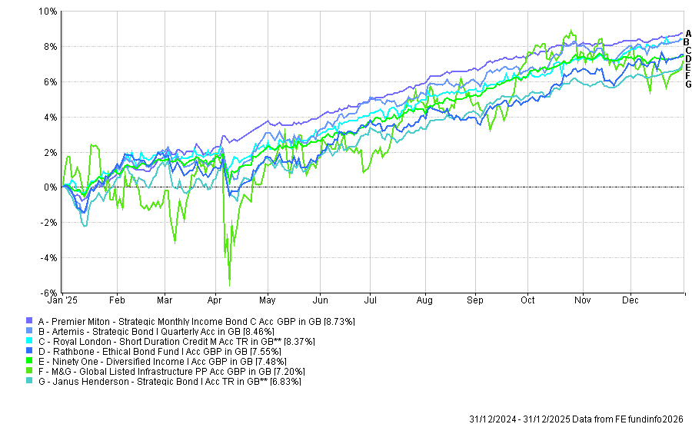
WHAT ACTUALLY HAPPENED IN 2025
Notes:
Good year across the board for equities, but the wobble was a short-lived bear market for some (correction >20% - S&P 500 in Sterling over 3 months)
UK did better, pipped by Europe; China was doing great but fizzled out towards the end.
Bonds (in blue) and alternatives (in green) provided a decent full year return of 7-8%; however, they provided excellent short-term support when equities tanked in April. If you were withdrawing money during these 3 months you would have been glad of them.
Gold & Silver became the new Bitcoin, whilst Bitcoin was all volatility & no return. We had been monitoring precious metals since before 2025 and jumped in during October just before things got really exciting with exposure via a Global Mining ETF.

Slide 44
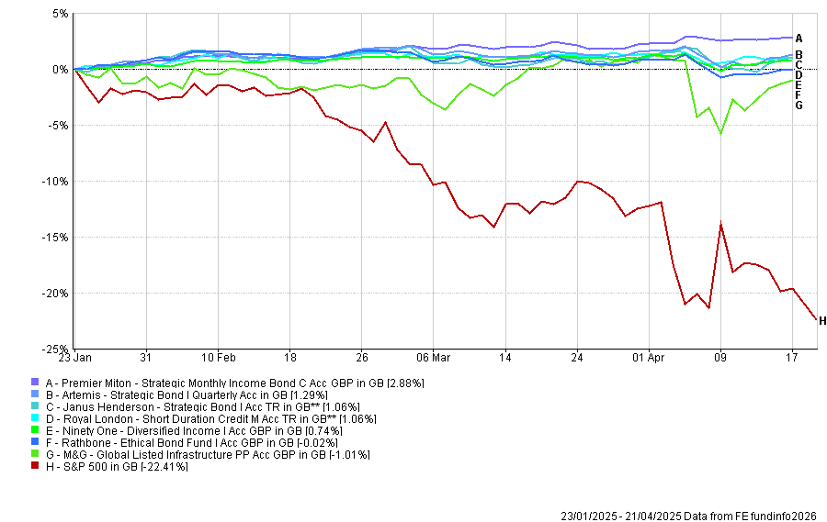
WHAT ACTUALLY HAPPENED IN 2025
Notes:
Good year across the board for equities, but the wobble was a short-lived bear market for some (correction >20% - S&P 500 in Sterling over 3 months)
UK did better, pipped by Europe; China was doing great but fizzled out towards the end.
Bonds (in blue) and alternatives (in green) provided a decent full year return of 7-8%; however, they provided excellent short-term support when equities tanked in April. If you were withdrawing money during these 3 months you would have been glad of them.
Gold & Silver became the new Bitcoin, whilst Bitcoin was all volatility & no return. We had been monitoring precious metals since before 2025 and jumped in during October just before things got really exciting with exposure via a Global Mining ETF.

Slide 45
WHAT ACTUALLY HAPPENED IN 2025
Financial Markets
Global equity markets performed strongly, despite wobbles in February & April
UK equities were near the top of the pack, US equities underperformed
Bond markets and alternative investments provided support during equity wobbles
Very strong year for gold & silver, Bitcoin lost 10%, US Dollar lost nearly 10%
Notes:
Good year across the board for equities, but the wobble was a short-lived bear market for some (correction >20% - S&P 500 in Sterling over 3 months)
UK did better, pipped by Europe; China was doing great but fizzled out towards the end.
Bonds (in blue) and alternatives (in green) provided a decent full year return of 7-8%; however, they provided excellent short-term support when equities tanked in April. If you were withdrawing money during these 3 months you would have been glad of them.
Gold & Silver became the new Bitcoin, whilst Bitcoin was all volatility & no return. We had been monitoring precious metals since before 2025 and jumped in during October just before things got really exciting with exposure via a Global Mining ETF.

Slide 46
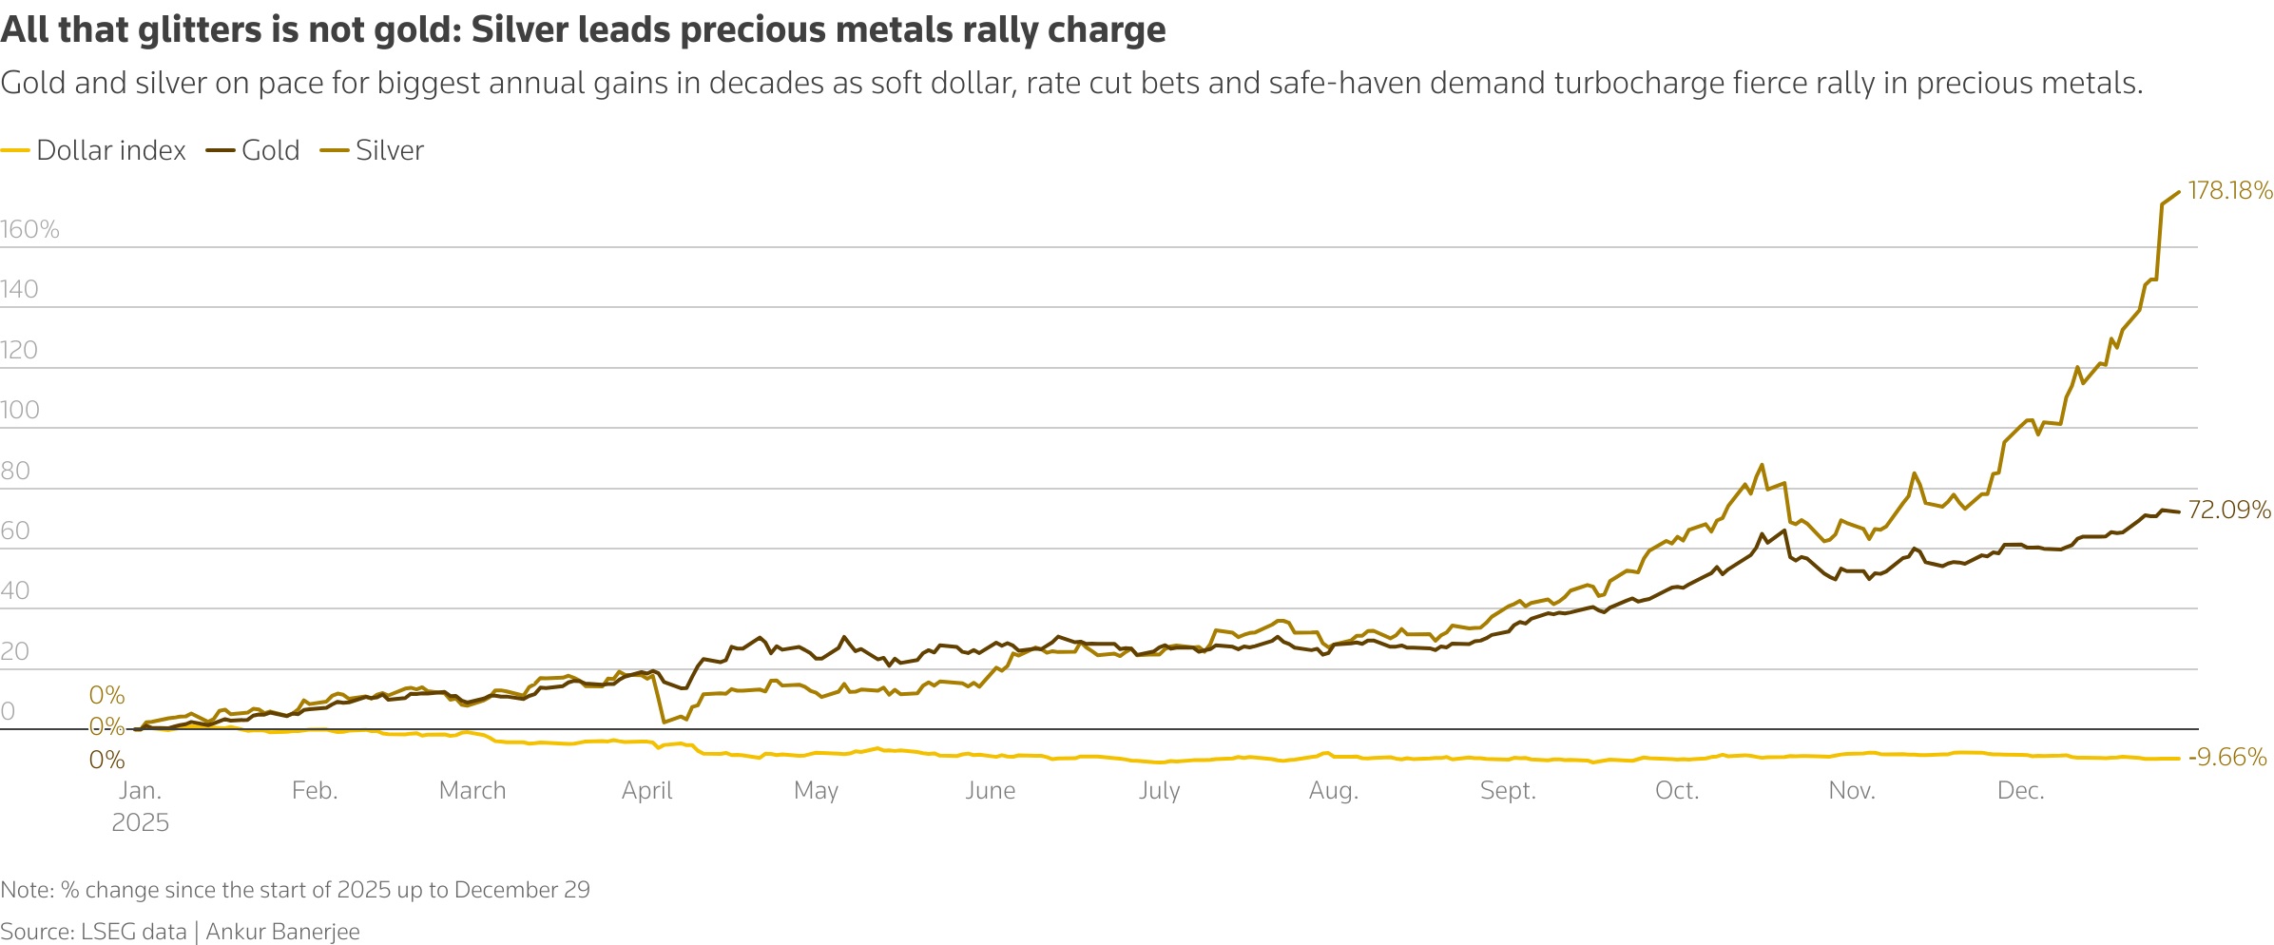
WHAT ACTUALLY HAPPENED IN 2025
Notes:
Good year across the board for equities, but the wobble was a short-lived bear market for some (correction >20% - S&P 500 in Sterling over 3 months)
UK did better, pipped by Europe; China was doing great but fizzled out towards the end.
Bonds (in blue) and alternatives (in green) provided a decent full year return of 7-8%; however, they provided excellent short-term support when equities tanked in April. If you were withdrawing money during these 3 months you would have been glad of them.
Gold & Silver became the new Bitcoin, whilst Bitcoin was all volatility & no return. We had been monitoring precious metals since before 2025 and jumped in during October just before things got really exciting with exposure via a Global Mining ETF.

Slide 47

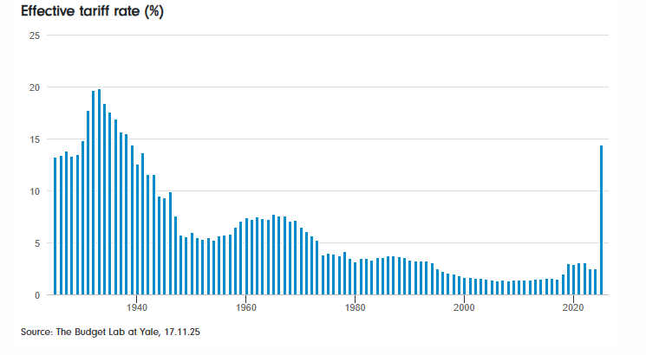
THE ART OF THE TARIFF
Notes:
Trump’s tariffs were introduced to address trade imbalances, protect American industries & pressure trading partners on issues like unfair practices & national security.
They also handily bring in tax revenues to replace taxes cut in his “One Big Beautiful Bill”
However, they take global trade with the US back to the 1940s in terms of the scale of tariffs due.
The tariffs that have been settled on to date are much lower than those outlined last April but are still meaningful.
2025 tariff receipts surged by $118 billion (153%), which some estimates say may narrow the 2025 budget deficit slightly to $1.8 trillion (but still roughly twice what it was in 2019).

Slide 48
THE ART OF THE TARIFF
February 2025: Trump floats tariff threats
  Equity markets fall
2nd April 2025: “Liberation Day” Speech
  Sweeping new tariffs on a broad set of trading partners
  Equity markets plunged sharply as investors priced in a possible trade war
By Mid-April: Bond Market Reacts Strongly
  Sell-off in US Treasuries reflecting fears of inflation/disruption
  Suggested traders were pricing in tightening financial conditions
May 2025 Onwards: Markets Bounce
  By mid-2025, the S&P 500 & Nasdaq were climbing back toward record highs
  Driven by tech stocks & easing fears of prolonged tariff escalation
Notes:
Trump’s tariffs were introduced to address trade imbalances, protect American industries & pressure trading partners on issues like unfair practices & national security.
They also handily bring in tax revenues to replace taxes cut in his “One Big Beautiful Bill”
However, they take global trade with the US back to the 1940s in terms of the scale of tariffs due.
The tariffs that have been settled on to date are much lower than those outlined last April but are still meaningful.
2025 tariff receipts surged by $118 billion (153%), which some estimates say may narrow the 2025 budget deficit slightly to $1.8 trillion (but still roughly twice what it was in 2019).

Slide 49

THE “TACO” PHENOMENON
Trump issues dramatic policy threats
Markets sell off
Trump delays or softens implementation
Markets rebound sharply as threats fade

Slide 50

HOW TRUMP REACTED:
REALPOLITIK MEETS MARKETS
Bond market reactions (rising yields) & equity volatility were signs
of market stress
Trump paused or rolled back tariffs when conditions worsened
January 2026: renewed tariff threats against Europe
  More market volatility
  Trump quickly drops the harshest levies
  European and US markets rally strongly
Markets have learned to buy the dip on presidential brinkmanship
Notes:
- Because when the pressure mounts, history suggests Trump might “always chicken out” & markets reflate

Slide 51

CALMER MARKETS, LOUDER POLITICS
Bond Markets price cash flows, not headlines
Belief in Central Bank intervention
Huge fiscal stimulus (tax cuts & government spending)
Strong corporate earnings
Dominance of a few mega-cap stocks with strong structural narratives
There is still a wall of money
Markets have adapted to permanent crisis
– Fragility only shows up when something forces repricing
8. Market complacency?
Notes:
Markets don’t move on how many risks exist - they move on whether risks are changing expected profits or liquidity conditions.
So far:
Most wars and geopolitical conflicts have been regionally contained in economic terms.
Global supply chains have bent, not broken.
Corporate earnings (especially in the US) have remained resilient.
After 15+ years of intervention-heavy monetary regimes, markets are conditioned to believe that if things get bad enough, policy will respond.
Even in 2025:
Rate cuts are expected at the first sign of slowdown
Liquidity tools are assumed to exist
Governments are willing to run very large deficits
This creates a structural mindset: risks are cushioned.
That doesn’t remove risk - it suppresses volatility until something overwhelms that belief (as in 2008 or 2020).
Despite the risks:
Pension funds must allocate
Sovereign wealth funds must deploy
Buybacks remain large
Retail flows are persistent
Since 2008, markets have lived through:
Eurozone break-up risk
US debt ceiling crises
Pandemic shutdowns
War in Europe
Inflation shock
Banking mini-crises
Trade wars
Markets are not saying “There are no risks”, they are saying “None of these risks are yet impairing the earnings/liquidity machine.”

Slide 52
MAKE VOLATILITY GREAT AGAIN
- KEY RISKS
High valuations in a low-attention world
Notes:
High valuations are fine as long as they continue to be justified by strong future earnings – when they are not, the stock re-rates downwards to reflect the new reality.
High valuations do not cause crashes, they simply remove shock absorbers.
When there is high stock concentration an index can be dragged down by just a few stocks
The danger is not that these firms are “bad”, it’s just that so much capital is leaning the same way.
Bond markets become unstable when:
There is very high supply (because of high government borrowing)
Central banks no longer suppressing yields
Political pressure on deficits
Inflation is sticky
A disorderly rise in bond yields would hit the valuation of many asset types, including equities.
Historically, equity crises often begin as bond problems.
2026 risk isn’t just elections — it’s policy volatility:
tariffs and trade friction
fiscal confrontations
regulatory surprises
sanctions regimes
industrial policy distortions
A black swan event is an extremely rare, unpredictable occurrence with severe, widespread, and often paradigm-shifting consequences.
They are often not easily hedgeable and would be a genuine regime shock.
Markets are calm not because this risk is small, but because it is difficult to price.

Slide 53
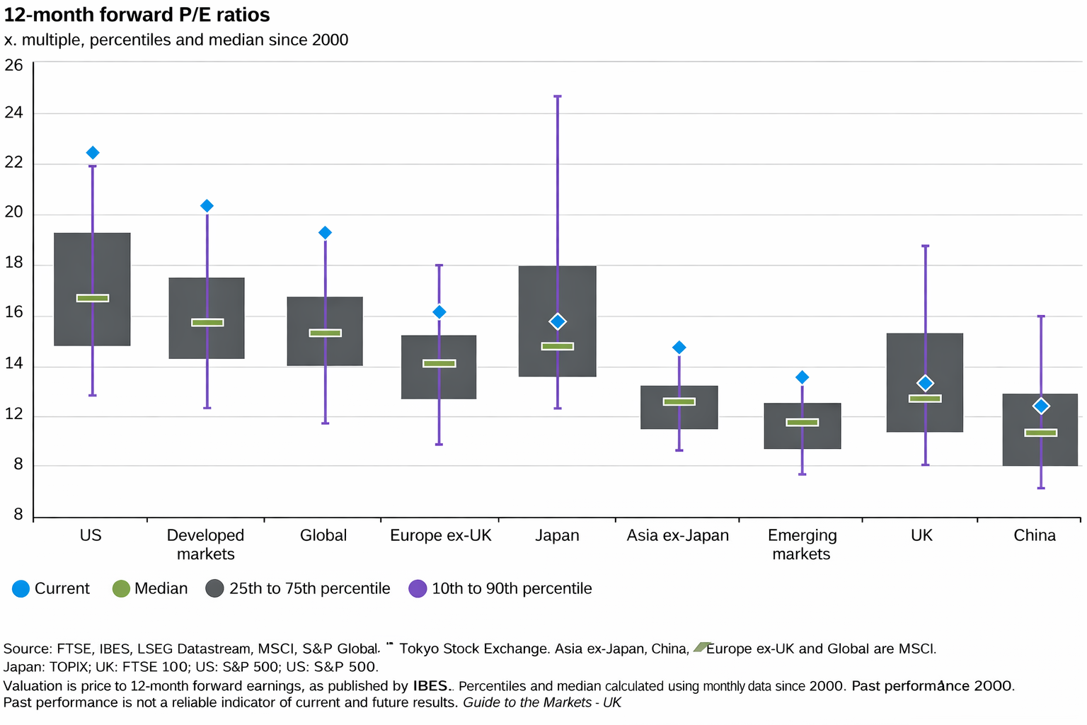
Notes:
High valuations are fine as long as they continue to be justified by strong future earnings – when they are not, the stock re-rates downwards to reflect the new reality.
High valuations do not cause crashes, they simply remove shock absorbers.
When there is high stock concentration an index can be dragged down by just a few stocks
The danger is not that these firms are “bad”, it’s just that so much capital is leaning the same way.
Bond markets become unstable when:
There is very high supply (because of high government borrowing)
Central banks no longer suppressing yields
Political pressure on deficits
Inflation is sticky
A disorderly rise in bond yields would hit the valuation of many asset types, including equities.
Historically, equity crises often begin as bond problems.
2026 risk isn’t just elections — it’s policy volatility:
tariffs and trade friction
fiscal confrontations
regulatory surprises
sanctions regimes
industrial policy distortions
A black swan event is an extremely rare, unpredictable occurrence with severe, widespread, and often paradigm-shifting consequences.
They are often not easily hedgeable and would be a genuine regime shock.
Markets are calm not because this risk is small, but because it is difficult to price.

Slide 54
MAKE VOLATILITY GREAT AGAIN
- KEY RISKS
High valuations in a low-attention world
Concentration risk (the hidden fragility)
Notes:
High valuations are fine as long as they continue to be justified by strong future earnings – when they are not, the stock re-rates downwards to reflect the new reality.
High valuations do not cause crashes, they simply remove shock absorbers.
When there is high stock concentration an index can be dragged down by just a few stocks
The danger is not that these firms are “bad”, it’s just that so much capital is leaning the same way.
Bond markets become unstable when:
There is very high supply (because of high government borrowing)
Central banks no longer suppressing yields
Political pressure on deficits
Inflation is sticky
A disorderly rise in bond yields would hit the valuation of many asset types, including equities.
Historically, equity crises often begin as bond problems.
2026 risk isn’t just elections — it’s policy volatility:
tariffs and trade friction
fiscal confrontations
regulatory surprises
sanctions regimes
industrial policy distortions
A black swan event is an extremely rare, unpredictable occurrence with severe, widespread, and often paradigm-shifting consequences.
They are often not easily hedgeable and would be a genuine regime shock.
Markets are calm not because this risk is small, but because it is difficult to price.

Slide 55
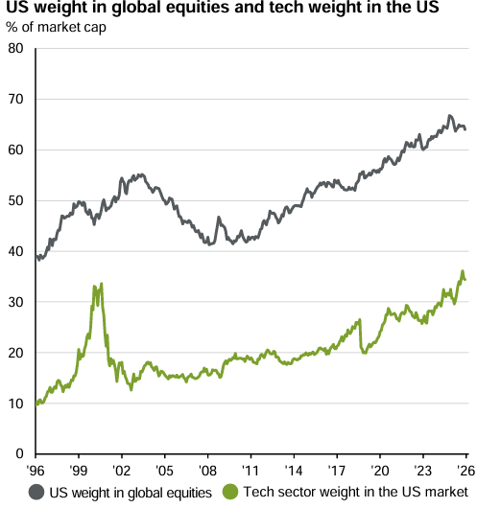
WHAT ACTUALLY HAPPENED IN 2025
Notes:
High valuations are fine as long as they continue to be justified by strong future earnings – when they are not, the stock re-rates downwards to reflect the new reality.
High valuations do not cause crashes, they simply remove shock absorbers.
When there is high stock concentration an index can be dragged down by just a few stocks
The danger is not that these firms are “bad”, it’s just that so much capital is leaning the same way.
Bond markets become unstable when:
There is very high supply (because of high government borrowing)
Central banks no longer suppressing yields
Political pressure on deficits
Inflation is sticky
A disorderly rise in bond yields would hit the valuation of many asset types, including equities.
Historically, equity crises often begin as bond problems.
2026 risk isn’t just elections — it’s policy volatility:
tariffs and trade friction
fiscal confrontations
regulatory surprises
sanctions regimes
industrial policy distortions
A black swan event is an extremely rare, unpredictable occurrence with severe, widespread, and often paradigm-shifting consequences.
They are often not easily hedgeable and would be a genuine regime shock.
Markets are calm not because this risk is small, but because it is difficult to price.

Slide 56
MAKE VOLATILITY GREAT AGAIN
- KEY RISKS
High valuations in a low-attention world
Concentration risk (the hidden fragility)
Bond market instability
Policy error & political volatility
Geopolitics: "Black Swan" events
Notes:
High valuations are fine as long as they continue to be justified by strong future earnings – when they are not, the stock re-rates downwards to reflect the new reality.
High valuations do not cause crashes, they simply remove shock absorbers.
When there is high stock concentration an index can be dragged down by just a few stocks
The danger is not that these firms are “bad”, it’s just that so much capital is leaning the same way.
Bond markets become unstable when:
There is very high supply (because of high government borrowing)
Central banks no longer suppressing yields
Political pressure on deficits
Inflation is sticky
A disorderly rise in bond yields would hit the valuation of many asset types, including equities.
Historically, equity crises often begin as bond problems.
2026 risk isn’t just elections — it’s policy volatility:
tariffs and trade friction
fiscal confrontations
regulatory surprises
sanctions regimes
industrial policy distortions
A black swan event is an extremely rare, unpredictable occurrence with severe, widespread, and often paradigm-shifting consequences.
They are often not easily hedgeable and would be a genuine regime shock.
Markets are calm not because this risk is small, but because it is difficult to price.

Slide 57

DE-DOLLARISATION
The Dollar’s Midlife Crisis
1. Central banks are dumping US Treasuries (debt)
Some central banks (China, India) have cut US Treasury holdings
But…
Bank of England, ECB & Japan have increased their holdings
Overall, foreign central bank Treasury holdings have risen
Conclusion
Not great news for US but not catastrophic (no $ collapse yet)
2. Emerging economies are shunning the Dollar
Many EM trade deals now use local currencies or swaps
(BRICS, ASEAN, Africa/Middle East, China/LatAm)
But…
Most of these countries have actually increased their Dollar reserves due to US tariffs
Notes:
I’ve talked about a weaker US Dollar – De-Dollarisation is a sub-theme of this, & refers to foreign countries shedding dollar exposure, causing further weaknesses.
I’ll address the two main de-dollarisation themes & comment on their likely impact.

Slide 58

2026: HEADS OR TAILS?
2026: HEADS OR TAILS?
Global backdrop
Global growth in 2026 looks modestly positive, but with clear regional winners & laggards
Inflation has eased from prior peaks, creating room for gradual rate cuts
Higher bond yields now support better long‑term return potential

Slide 59
2026: HEADS OR TAILS?
Key headwinds
Elevated equity valuations, led by US mega‑caps & AI‑themed stocks
Growing concentration risk from a narrow group of global leaders
Risk of policy error as governments persist with large deficits
Heightened political volatility & “Great Power” rivalry, scope for shock events
Deglobalisation, tariffs and reshoring pressuring productivity
Risk of renewed US inflation and higher rates

Slide 60
2026: HEADS OR TAILS?
Key tailwinds
Muddle-through" global growth bolsters corporate earnings & cash flows
Disinflation and rate cuts lift risk assets & bond returns
AI infrastructure, & green energy capex fuel multi-year themes
Equity leadership may broaden beyond US mega-caps
Attractive gilt & global bond yields restore portfolio income

Slide 61
2026: HEADS OR TAILS?
2026: HEADS OR TAILS?
Our view
Avoid over-reliance on US mega-caps & cap-weighted index trackers
Diversify globally by style, focus on active managers
Tilt to quality income, strong balance sheets & structural growth
Keep home bias to cut currency risk & capture valuation re-ratings
Access metals via diversified miners, not record-high gold/silver spot prices
Conclusion
Ingredients are all there for another positive year, but slim margin for error

Slide 62
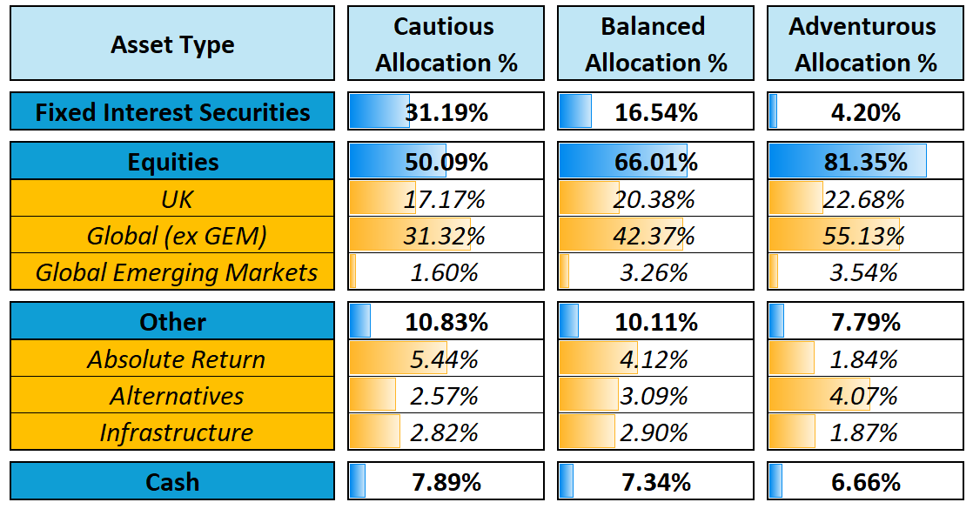
CURRENT BOOLERS FUND POSITIONING
29/01/2026
Notes:
To be updated on Weds
Since launch the Boolers investment funds are performing very well relatively and delivering on our original aims stated here last year:
Improved market timing (proactivity)
Better performance
Lower cost – Balanced fund had a a charge of 1.16% at launch, since reduced to 1.08% & we are working hard to reduce costs earlier without sacrificing quality
= better client outcomes

Slide 63
Improved Market Timing
Better Investment Performance
Driving Costs Lower
= Better Client Outcomes

Slide 64
Q&A
Carole Waghorne
Boolers
Craig Simpson
Simon Watts
Boolers
Gavin O’Neill
Boolers
Chris Ball
Boolers

Slide 65

QUESTIONS

Slide 66

COMPLIANCE DISCLAIMER SLIDE
David Booler and Co trading as Boolers and Boolers Pensions and Investments is authorised and regulated
by the Financial Conduct Authority. Firm reference number 146287.
Past performance is not indicative of future performance, and the value of your investment, as well as any income, may go down as well as up. You may get back less than you invested.
This presentation does not constitute nor is to be construed as advice. If advice is required, please contact us.
The content of this presentation is based on our understanding and interpretation of current legislation and taxation which may be subject to change.
We have taken all reasonable steps to ensure that the content is up to date for the purpose of this presentation.
If you require clarification on any point, please contact us directly.

Slide 67
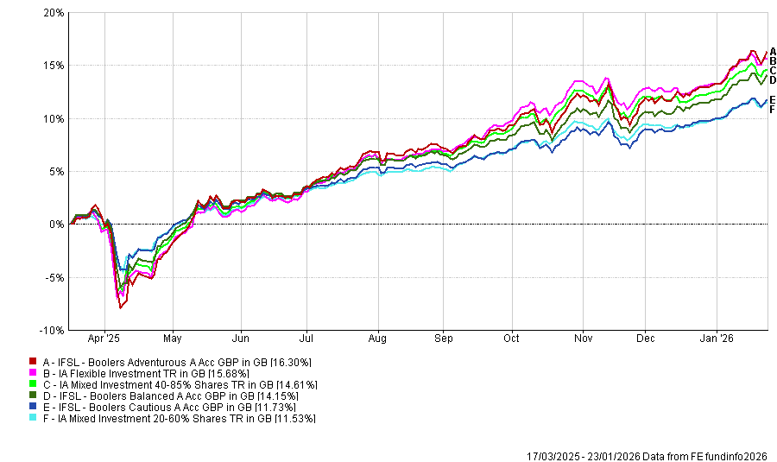
BOOLERS INVESTMENT FUNDS
Since Launch
Notes:
However, since launch the Boolers investment funds are performing very well relatively and delivering on our original aims stated here last year:
Improved market timing (proactivity)
Better performance
Lower cost – Balanced fund had a a charge of 1.16% at launch, since reduced to 1.08% & we are working hard to reduce costs earlier without sacrificing quality
= better client outcomes

Slide 68
PERFORMANCE OF BOOLERS INVESTMENT FUNDS
Portfolio | 1 Year to 31/12/2025 | 5 Years to 31/12/2025
Boolers Adventurous Fund | 10.56% | 37.86%
IA Flexible Investment Sector | 12.05% | 32.99%
Boolers Balanced Fund | 9.99% | 34.19%
IA Mixed Asset 40-85% Shares Sector | 11.59% | 31.17%
Boolers Cautious Fund | 8.80% | 28.46%
IA Mixed Asset 20-60% Shares Sector | 10.18% | 21.15%
Notes:
Covered in Year-End Commentary.
1yr relative performance slightly behind but 5yr comfortably ahead.
As we’ve seen, 2025 saw policy changes that could have been paradigm changing, so we lifted our foot off the risk pedal slightly.
Thanks to Taco & an increase in AI exuberance those who ignored real risk were rewarded – we simply took a more cautious stance.
2022 was a very good example of where a less prudent approach will cost you dearly.

